Slide 2
Section 2 History of Preservation
As we delve into this section, we will start to see the steps toward an English translation.
We will be looking at:
The Septuagint (LXX)
NT Origin and Distr.
The Tale of Two Cities
Westcott and Hort’s “Oldest Manuscripts”
Early Predecessors to the KJV

Slide 3
Section 2 History of Preservation
Define some terms for this section:
Manuscripts - is any handwritten copy of a portion of the text of the Bible.
Codex – is a book constructed of a number of sheets of paper, vellum, papyrus, or similar materials, with hand-written contents.

Slide 4
Section 2 History of Preservation
3 Codices we need to be concerned with:
Sinaticus Codex - The codex is an Alexandrian text-type manuscript written in the 4th century in uncial letters on parchment.

Slide 5
Section 2 History of Preservation
Alexandrinus Codex - is a 5th century manuscript in uncial letters of the Greek Bible, containing the majority of the Septuagint and the New Testament.
Vaticanus Codex - is a 4th century extant manuscript of the Greek Bible (Old and New Testament).
Scroll – also known as a roll, is a roll of papyrus, parchment, or paper containing writing. (Older than codex, was replaced by codex)

Slide 6
Section 2 History of Preservation
Lectionaries - A New Testament Lectionary is a handwritten copy of a lectionary, or book of New Testament Bible readings. Lectionaries may be written in uncial or minuscule Greek letters, on parchment, papyrus, vellum, or paper. (Appear around 6th Century – forward)

Slide 7
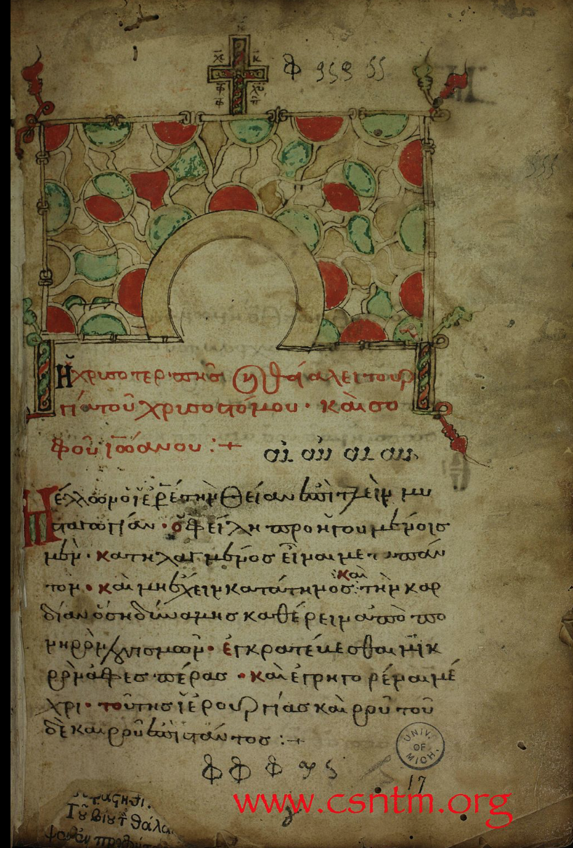
Lectionary 223 The codex contains 28 lessons from the Gospels and Epistles (Evangelistarium, Apostolarium] on 174 paper leaves (21 cm by 15.4 cm). The text is written in Greek minuscule letters, in one column per page, 22 lines per page.
Section 2 History of Preservation

Slide 8
Section 2 History of Preservation
Papyri – is a partial fragment of text or portion written on a material similar to thick paper (Pith of a papyrus plant) (Approximately 125~130 in existence, 150 AD – 6th Century)

Slide 9
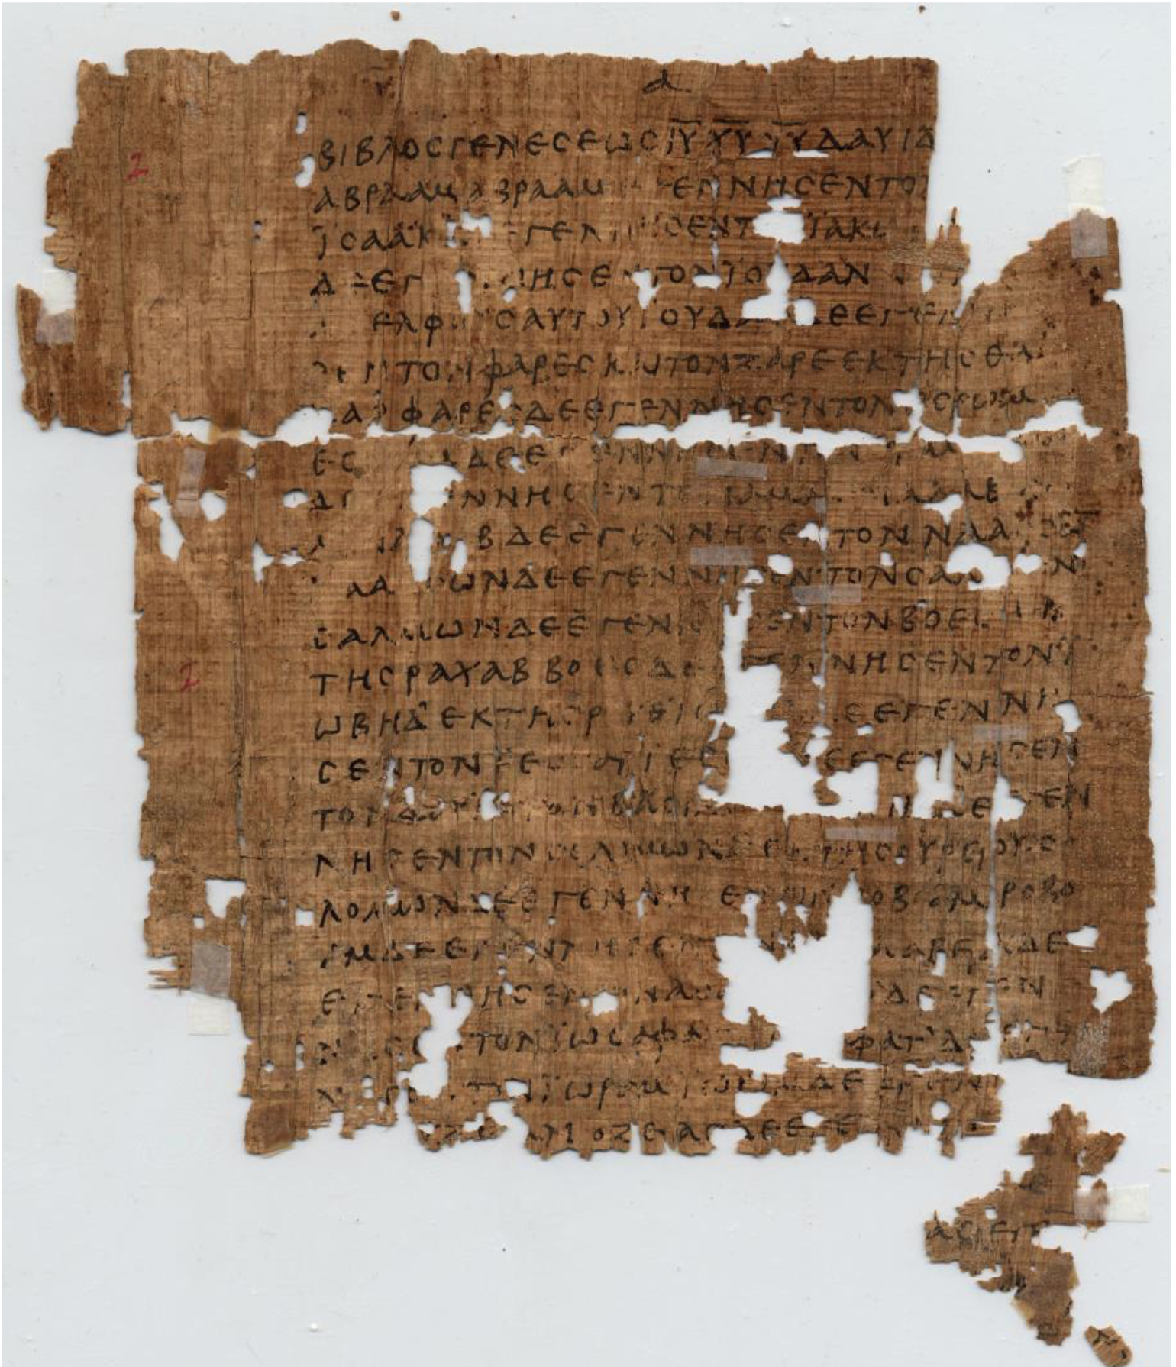
Fragment: Matthew 1:1-9, 12-13, 1:14-20, 23 (250 AD)
http://www.csntm.org/Manuscript/View/GA_P1
Section 2 History of Preservation

Slide 10
Section 2 History of Preservation
Uncials – written in Large Upper case letters, on parchment or velum. (4th – 10th Century)

Slide 11
Codex Sinaiticus 4th Century, Contains Complete NT
http://codexsinaiticus.org/en/manuscript.aspx?book=10&lid=en&side=r&zoomSlider=0
Section 2 History of Preservation

Slide 12
Section 2 History of Preservation
Minuscule - A New Testament minuscule is a copy of a portion of the New Testament written in a small, cursive Greek script (10th – 16th Century, Mostly the Gospel accounts)

Slide 13
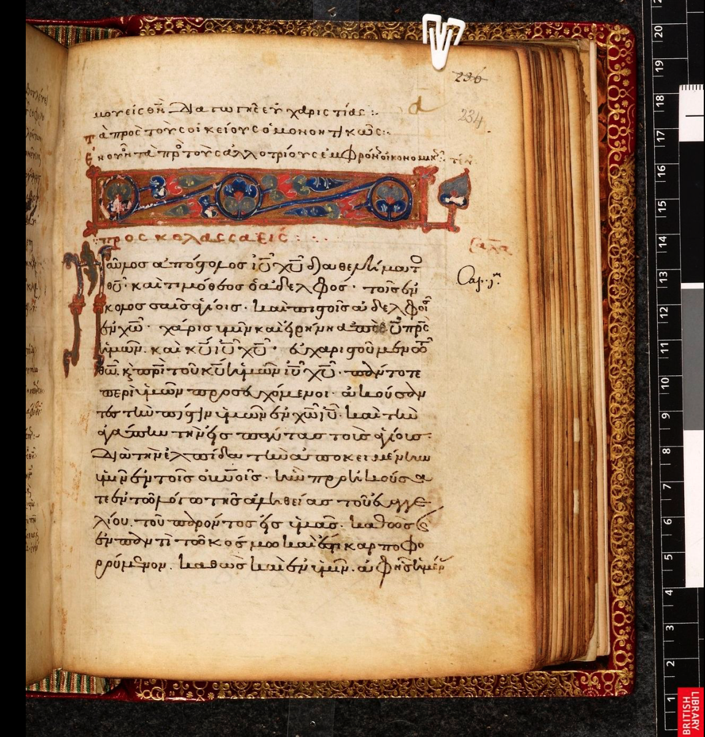
First Page of Colossians Codex Harleianus 5557 minuscule 321
http://www.bl.uk/manuscripts/Viewer.aspx?ref=harley_ms_5557_f027r
Section 2 History of Preservation

Slide 14
Section 2 History of Preservation
The New Testament has been preserved in more manuscripts than any other ancient work. The dates of these manuscripts range from c. 125 (the P52 papyrus, oldest copy of John fragments) to the introduction of printing in Germany in the 15th century.

Slide 15
Section 2 History of Preservation
There are more manuscripts that preserve the New Testament than there are for any other ancient writing, the exact form of the text preserved in later manuscripts may not be identical to the form of the text as it existed in antiquity but are agreed by most scholars to be 99.5% identical in content, with the differing .5% attributed to minor variations such as spelling.

Slide 16
Section 2 History of Preservation
Autographs –
Apographs –
The original document penned by its human author. There are no Autographs in existence today.
A copy of the original document or portion thereof

Slide 17
Section 2 History of Preservation
Text – A compilation of manuscripts evidence that is used to form the Bible. (3 Major competing texts/ potentially 2 depending on how they are grouped/ 1. Received Text 2. Critical Text 3. Majority Text)

Slide 18
Section 2 History of Preservation
The Majority Text – the majority text is relatively a new thing put out by Dallas Theological Seminary in the early 1980s. It disagrees with the Received Text in the less than 1% of its readings. Before 1982 this term was used synonymously with “Received Text.”

Slide 19
Section 2 History of Preservation
The Textus Receptus (Syn. : Received Text, Traditional Text, Byzantine Greek Text, Antiochian Text)- is the name subsequently given to the succession of printed Greek texts of the New Testament which was first collated by Erasmus in the 16th century.

Slide 20
Section 2 History of Preservation
It constituted the translation base for the translation of the New Testament into English by William Tyndale, the King James Version.

Slide 21
Section 2 History of Preservation
The Critical Text (Syn. : Alexandrian Text, Minority Text, Westcott and Hort Text, Nestle-Aland Text, Eclectic Text) – This “new” Greek text put forth in the late 1800s, is an attempt to reconstruct or restore the true Bible text of the New Testament by assigning higher importance to the few “oldest manuscripts” rather than trusting the larger body of evidence in the Received Text.

Slide 22
Section 2 History of Preservation
The Septuagint (LXX) Origin
Was the first Greek translation of the Hebrew Old Testament.
The name Septuagint (from the Latin septuaginta, “70”) was derived later from the legend that there were 72 translators, 6 Jews from each of the 12 tribes of Israel, who worked independently to translate the whole Old Testament and ultimately produced identical versions.

Slide 23
Section 2 History of Preservation
Another legend holds that the translators were sent to Alexandria by Eleazar, the chief priest at Jerusalem, at the request of Ptolemy II Philadelphus (285–246 bce), though its source, the Letter of Aristeas, is unreliable.
Understand then the Septuagint is a Greek translation of the original Hebrew text.

Slide 24
Section 2 History of Preservation
“They reflect a method of close adherence to the source text in word order, lexical consistency, phrasing, and parataxis (the placing of clauses or phrases one after another).” “The balance between consistency and formal equivalence on the one hand and a degree of freedom on the other is a marker of the Septuagint as much as the Egyptian translations.” [Addition mine]

Slide 25
Section 2 History of Preservation
NT Origin and Dissemination

Slide 26
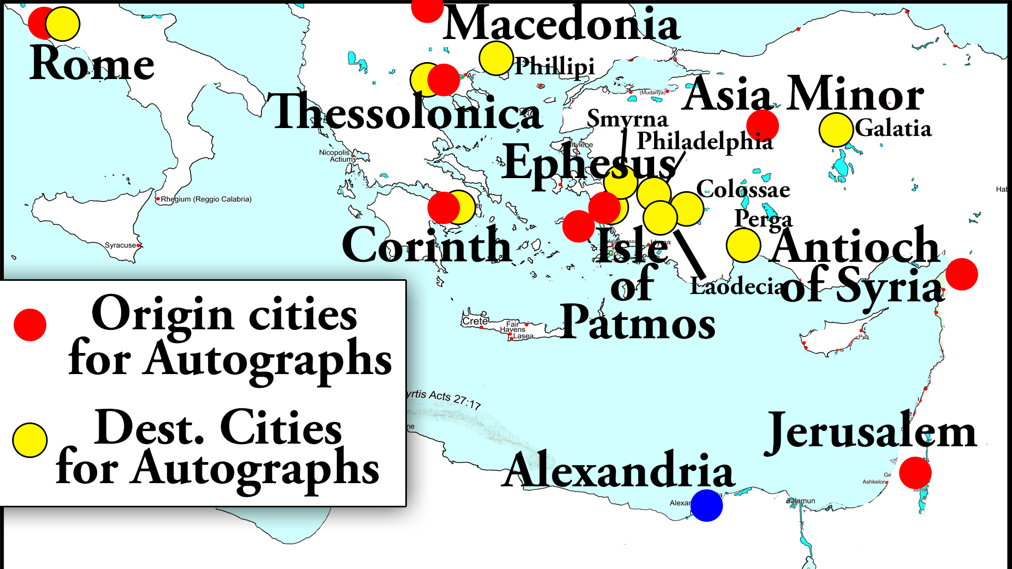
Section 2 History of Preservation
NT Origin and Dissemination

Slide 27
Section 2 History of Preservation
The Tale of Two Cities:
Alexandria
Antioch of Syria

Slide 28
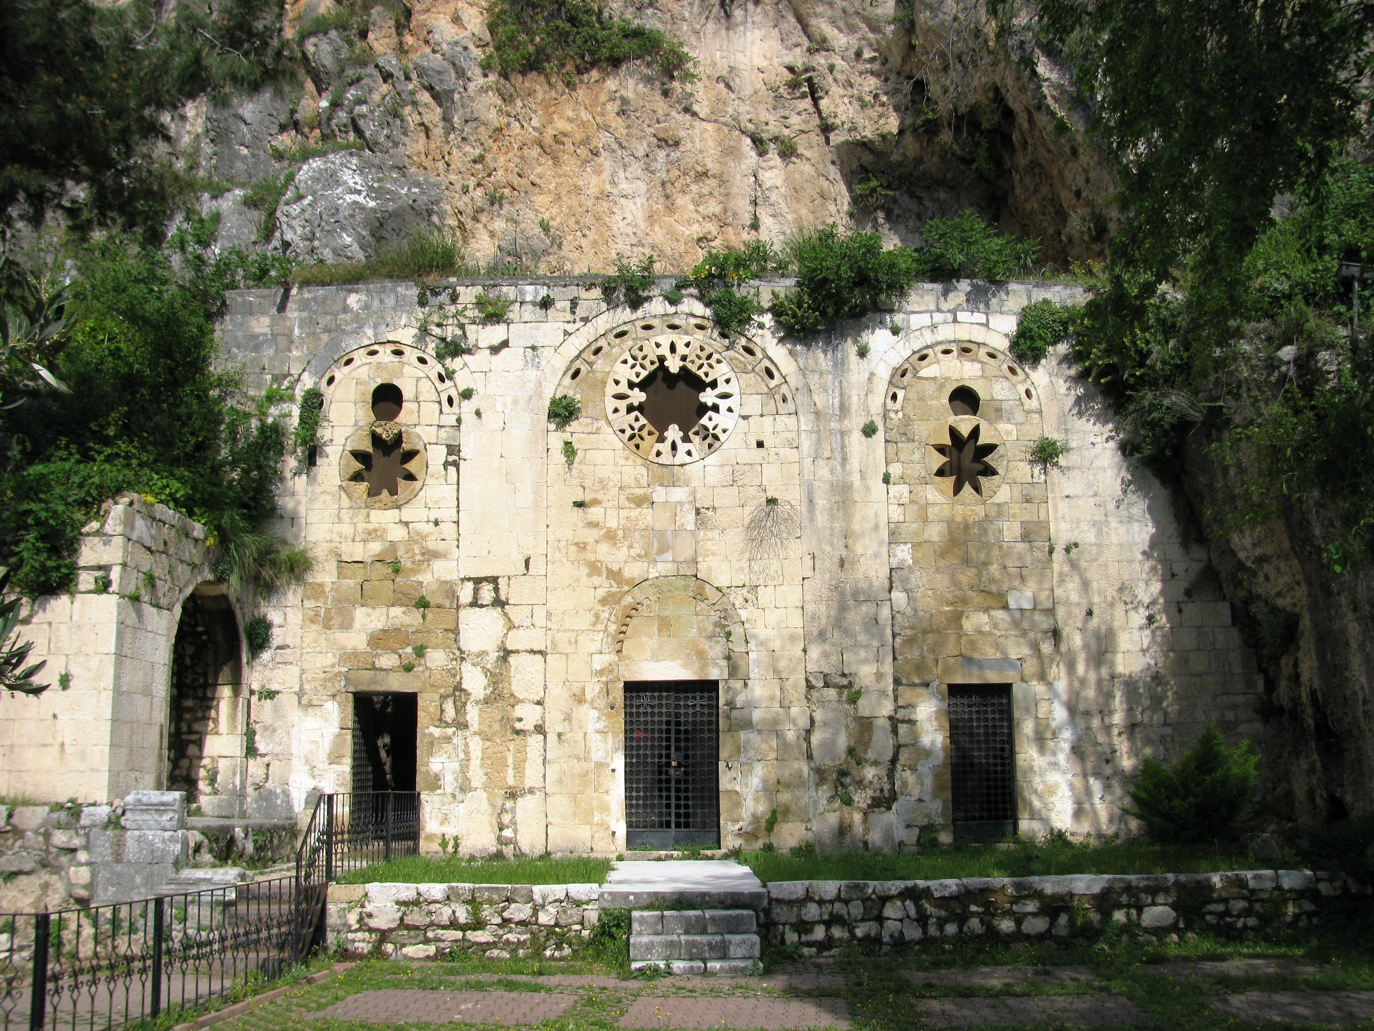
Section 2 History of Preservation
Cave Church of Peter in Syrian Antioch

Slide 29
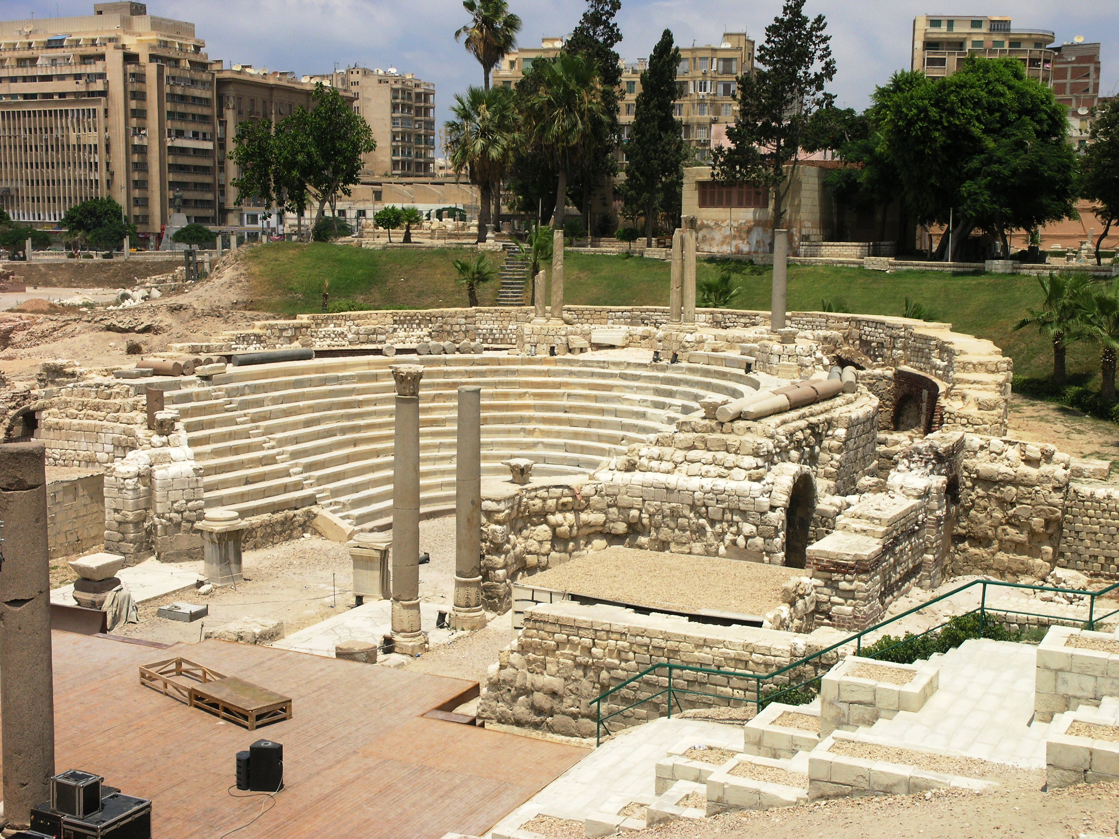
Section 2 History of Preservation
Excavations in Alexandria, Egypt

Slide 30
Section 2 History of Preservation
NT Origin and Dissemination

Slide 31
Section 2 History of Preservation
Alexandria – One of the two competing “colleges” of thought.
According to Jerome the Alexandrian school was founded by Mark the Apostle. The earliest recorded dean was supposedly Athenagoras (176 AD)
The School at Alexandria held to an allegorical interpretation and was influenced by Gnosticism.

Slide 32
Section 2 History of Preservation
Gnosticism was perhaps the most dangerous heresy that threatened the early church during the first three centuries. Influenced by such philosophers as Plato, Gnosticism is based on two false premises. First, it espouses a dualism regarding spirit and matter. Gnostics assert that matter is inherently evil and spirit is good.

Slide 33
Section 2 History of Preservation
As a result of this presupposition, Gnostics believe anything done in the body, even the grossest sin, has no meaning because real life exists in the spirit realm only. Gnostics seem to have originated in Alexandria and coexisted with the early Christians until the 4th Century AD.

Slide 34
Section 2 History of Preservation
The other problem with the school at Alexandria was a purely allegorical interpretation method. An Allegory is a figurative sentence or discourse, in which the principal subject is described by another subject resembling it in its properties and circumstances.
Example is Pilgrims Progress (Read Pilgrims Progress)

Slide 35
Section 2 History of Preservation
In allegorical interpretation, the interpreter is left to really pull any meaning out of the text he so desires and thus destroy the literal sense. This allegorical interpretation was an attempt to accommodate Greek philosophy alongside Biblical teaching. Allegorical interpretation states that the literal words are not as important as the hidden meaning to be found.

Slide 36
Section 2 History of Preservation
One of the notable men that came from that school was Origen. Origen believed that the “Scriptures are of little use to those who understand them as they are written.” His teachings on the pre-existence of souls, the final reconciliation of all creatures, including perhaps even the devil (the apokatastasis), and his possible belief that God the Son was subordinate to God the Father, were rejected by Christian orthodoxy.

Slide 37
Section 2 History of Preservation
Antioch - One of the two competing “colleges” of thought. The earliest mention of the school is around 170 AD. Those in Antioch held to a more literal and occasionally typological exegesis. This city also was in the region of the proliferation of manuscripts. Antioch would have had the closest ties to the early 1st century church as it developed in the early 1st century. Antioch is also the place where Christians were first called Christians. This city is the first place where missionaries were sent out from.

Slide 38
Section 2 History of Preservation
“There is also a possibility that the church in this city translated the Greek text into the Syriac Peshitta as well as the Old Latin Itala. These Itala Christians would later become known as the Waldenses. These Christians were recognized by Theodore Beza as the remainder of the most pure primitive Christians church.

Slide 39
Section 2 History of Preservation
Theodore Beza – Was the successor of John Calvin at Geneva. He also continued in the line of the Received Text editions. His 1598 Greek edition was also used heavily by the King James translators. Beza believed his manuscripts were influenced by Waldensian Christians – an early group of Christians, outside of Catholicism, dating back to 120 AD.”

Slide 40
Section 2 History of Preservation
The question arises from these two “areas”, where are we likely to have pure manuscripts and where are we likely to run into altered manuscripts?
Reference Preservation/Translation Chart

Slide 42
Section 2 History of Preservation
Westcott and Hort’s ‘Oldest Manuscripts’

Slide 43
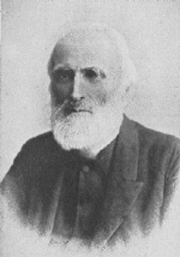
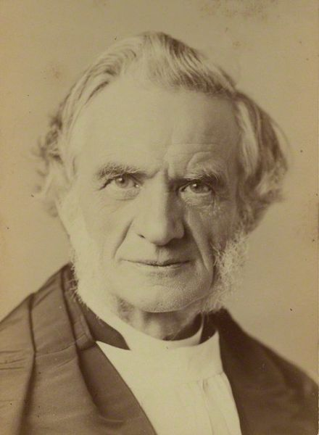
Section 2 History of Preservation
Wescott
Hort

Slide 44
Section 2 History of Preservation
Brooke Foss Westcott - (12 January 1825 – 27 July 1901) was a British bishop, biblical scholar and theologian, serving as Bishop of Durham from 1890 until his death. He is perhaps most known for co-editing The New Testament in the Original Greek in 1881.
Fenton John Anthony Hort - (23 April 1828 – 30 November 1892) was an Irish-born theologian[1] and editor, with Brooke Foss Westcott of a critical edition of The New Testament in the Original Greek.

Slide 45
Section 2 History of Preservation
Brooke Foss Westcott - (12 January 1825 – 27 July 1901) was a British bishop, biblical scholar and theologian, serving as Bishop of Durham from 1890 until his death. He is perhaps most known for co-editing The New Testament in the Original Greek in 1881.
Fenton John Anthony Hort - (23 April 1828 – 30 November 1892) was an Irish-born theologian[1] and editor, with Brooke Foss Westcott of a critical edition of The New Testament in the Original Greek.

Slide 46
Section 2 History of Preservation
These two men used 45 out of 5,255 manuscripts to come up with a ‘new Greek text’ and predominately used two particular manuscripts the Vanticanus [more so than the Sinaiticus] and the Sinaiticus. These two manuscripts disagree in 5,604 places with each other.

Slide 47
Section 2 History of Preservation
The other ‘Oldest Manuscript’ was found by Constatin Von Tischendorf, “a man who had given his life to “restore” the text of the early church.” In his words after no satisfaction in his quest, “but we have at last hit upon a better plan even than this, which is to set aside the Textus Receptus altogether, and to construct a fresh text, derived immediately from the most ancient sources.”

Slide 48
Section 2 History of Preservation
“With this “faith” in restoring God’s Word, he searched near and far for ancient manuscripts. In 1844, at St. Catherines’ Monsatery at Mount Sinai, he found what would be known as the Sinaticus. The librarian told him the pages were consigned to the fire as rubbish. To say it another way, this Greek Orthodox monastery saw no value in the Greek monuscripts that Tischendorf “found.” It was these rejected pages that formed, along with the Vaticanus (whose history is unknown), the primary basis for the Critical Text.”

Slide 49
Section 2 History of Preservation
In these oldest text a member of the ‘revision committee’ Dr. F.H.A Scrivener noted about the Sinaiticus, it “is covered with such alterations, brought in by at least ten different revisers, some of them systematically spread over every page… [Emphasis His].”

Slide 50
Section 2 History of Preservation
Speaking of these two “oldest and best manuscripts”
“…the Vatican, the Alexandrian, and now the Sinai. It is expressly admitted that neither of these has an extant history. No documentary external evidence exists as to the names of the copyists who transcribed them, the date, or the place of the writing.

Slide 51
Section 2 History of Preservation
Nobody knows when the Vatican MS came to the Pope’s library, or how long it had been there…Tischendorf himself was unable to trace the presence of his favorite Codex, in the monastery of St. Catherine on Mt. Horeb, by external witnesses, higher than the twelve century. Their early date is confessedly assigned by conjecture [ in other words- “we guessed!”]…[emphasis added].”

Slide 52
Section 2 History of Preservation
1. Hort did not believe in the Scriptures are infallible.
2. Hort firmly believed that no one ever attempted to change the Scripture in order to promote false doctrine.
“There are no signs of deliberate falsification of the text for dogmatic purposes.”
2 Peter 3: 15-16
2 Corinthians 2:17
2 Corinthians 4:2

Slide 53
Section 2 History of Preservation
3. Both Westcott and Hort believed that the Traditional Text could be explained by the ‘collective effort of the church.’ This leads to the idea of ‘weighing’ the manuscripts
4. Wescott and Hort believed that the older manuscripts were more likely to be better.
5. Westcott and Hort also believed that the shorter reading is more likely to be accurate than the longer reading.

Slide 54
Section 2 History of Preservation
6. Westcott and Hort believed there were many errors and mistakes made by the scribes.
Think about the biased involved in ‘revising’ a text.

Slide 55
Section 2 History of Preservation
Early Predecessors to the KJV
Originals –
We start with autographs then copies of autographs (apographs). Two major languages to consider; Latin amongst the Romans, and then Greek (Koine) as the common language.

Slide 56
Section 2 History of Preservation
Koine Greek had become a shared language around the eastern Mediterranean and into Asia Minor as a consequence of the conquests of Alexander the Great. The "linguistic frontier" dividing the Latin West and the Greek East passed through the Balkan peninsula.

Slide 57
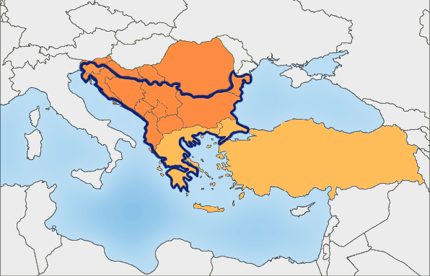
Section 2 History of Preservation

Slide 58
Section 2 History of Preservation
Syrian Peshitta – “The Peshitta is a collection of Aramaic manuscripts of the Bible. Aramaic was the most common “shared language” among people of the Near East and Middle East for many centuries. This includes the years immediately before and after the earthly ministry of Jesus.

Slide 59
Section 2 History of Preservation
Waldensians [Latin Bibles] (1100 AD – 1300 AD)
(Precursors to the Reformation [1517] groups who separated from the growing apostasy in the Catholic Church) [Messalianam Euchites, Montanists, Novations, Paulicians, and Waldense, Albigenses, Vaudois, Cathari etc..]

Slide 60
“It seems likely that the Old Latin was translated in Syrian Antioch by missionaries going to the West. Existing manuscripts certainly show a strong Syrian and Aramaic tendency. This being the case, the Old Latin is associated with that city which is the missionary center of the Book of Acts and had immediate concourse with those centers in Asia Minor which received the Epistles of Paul. History is so unanimous to Antioch being the fountainhead of the Traditional Text that it has been called the “Antiochan Text.”

Slide 61
Section 2 History of Preservation
Erasmus Greek N.T. 1522 AD
“Erasmus was a Catholic Priest who saw and spoke against the corruption of Catholic doctrine. He considered his life purpose to be a quest for pure scholarship. This quest caused him to reject the teachings of Rome and also prevented him from aligning closely with the Reformers. [Why was this? Reformation was not a total break back to the Bible, but rather a reforming from within.

Slide 62
Section 2 History of Preservation
As Baptist History indicates there were those ‘separatists’ who were not looking to renovate, but rather were separate.] His contribution to the textual issue is the Greek text he edited and printed in 1516, followed by four other editions. He led the way in going back to a Greek source, rather than a Latin source for the Bible.” [Explanation Mine] The motivation for Erasmus was to speak against the corrupt ‘Latin Vulgate’ widely used by the church of Rome which was translated by Jerome. (1517 – 1648 Protestant Reformation)

Slide 63
Section 2 History of Preservation
Luther Bible (German) 1522 AD – 1534 AD
“He translated from the Greek text, using Erasmus' second edition (1519) of the Greek New Testament, known as the Textus Receptus. Luther did not translate directly from the Latin Vulgate translation, which was the Latin translation officially used by the Roman Catholic Church.”

Slide 64
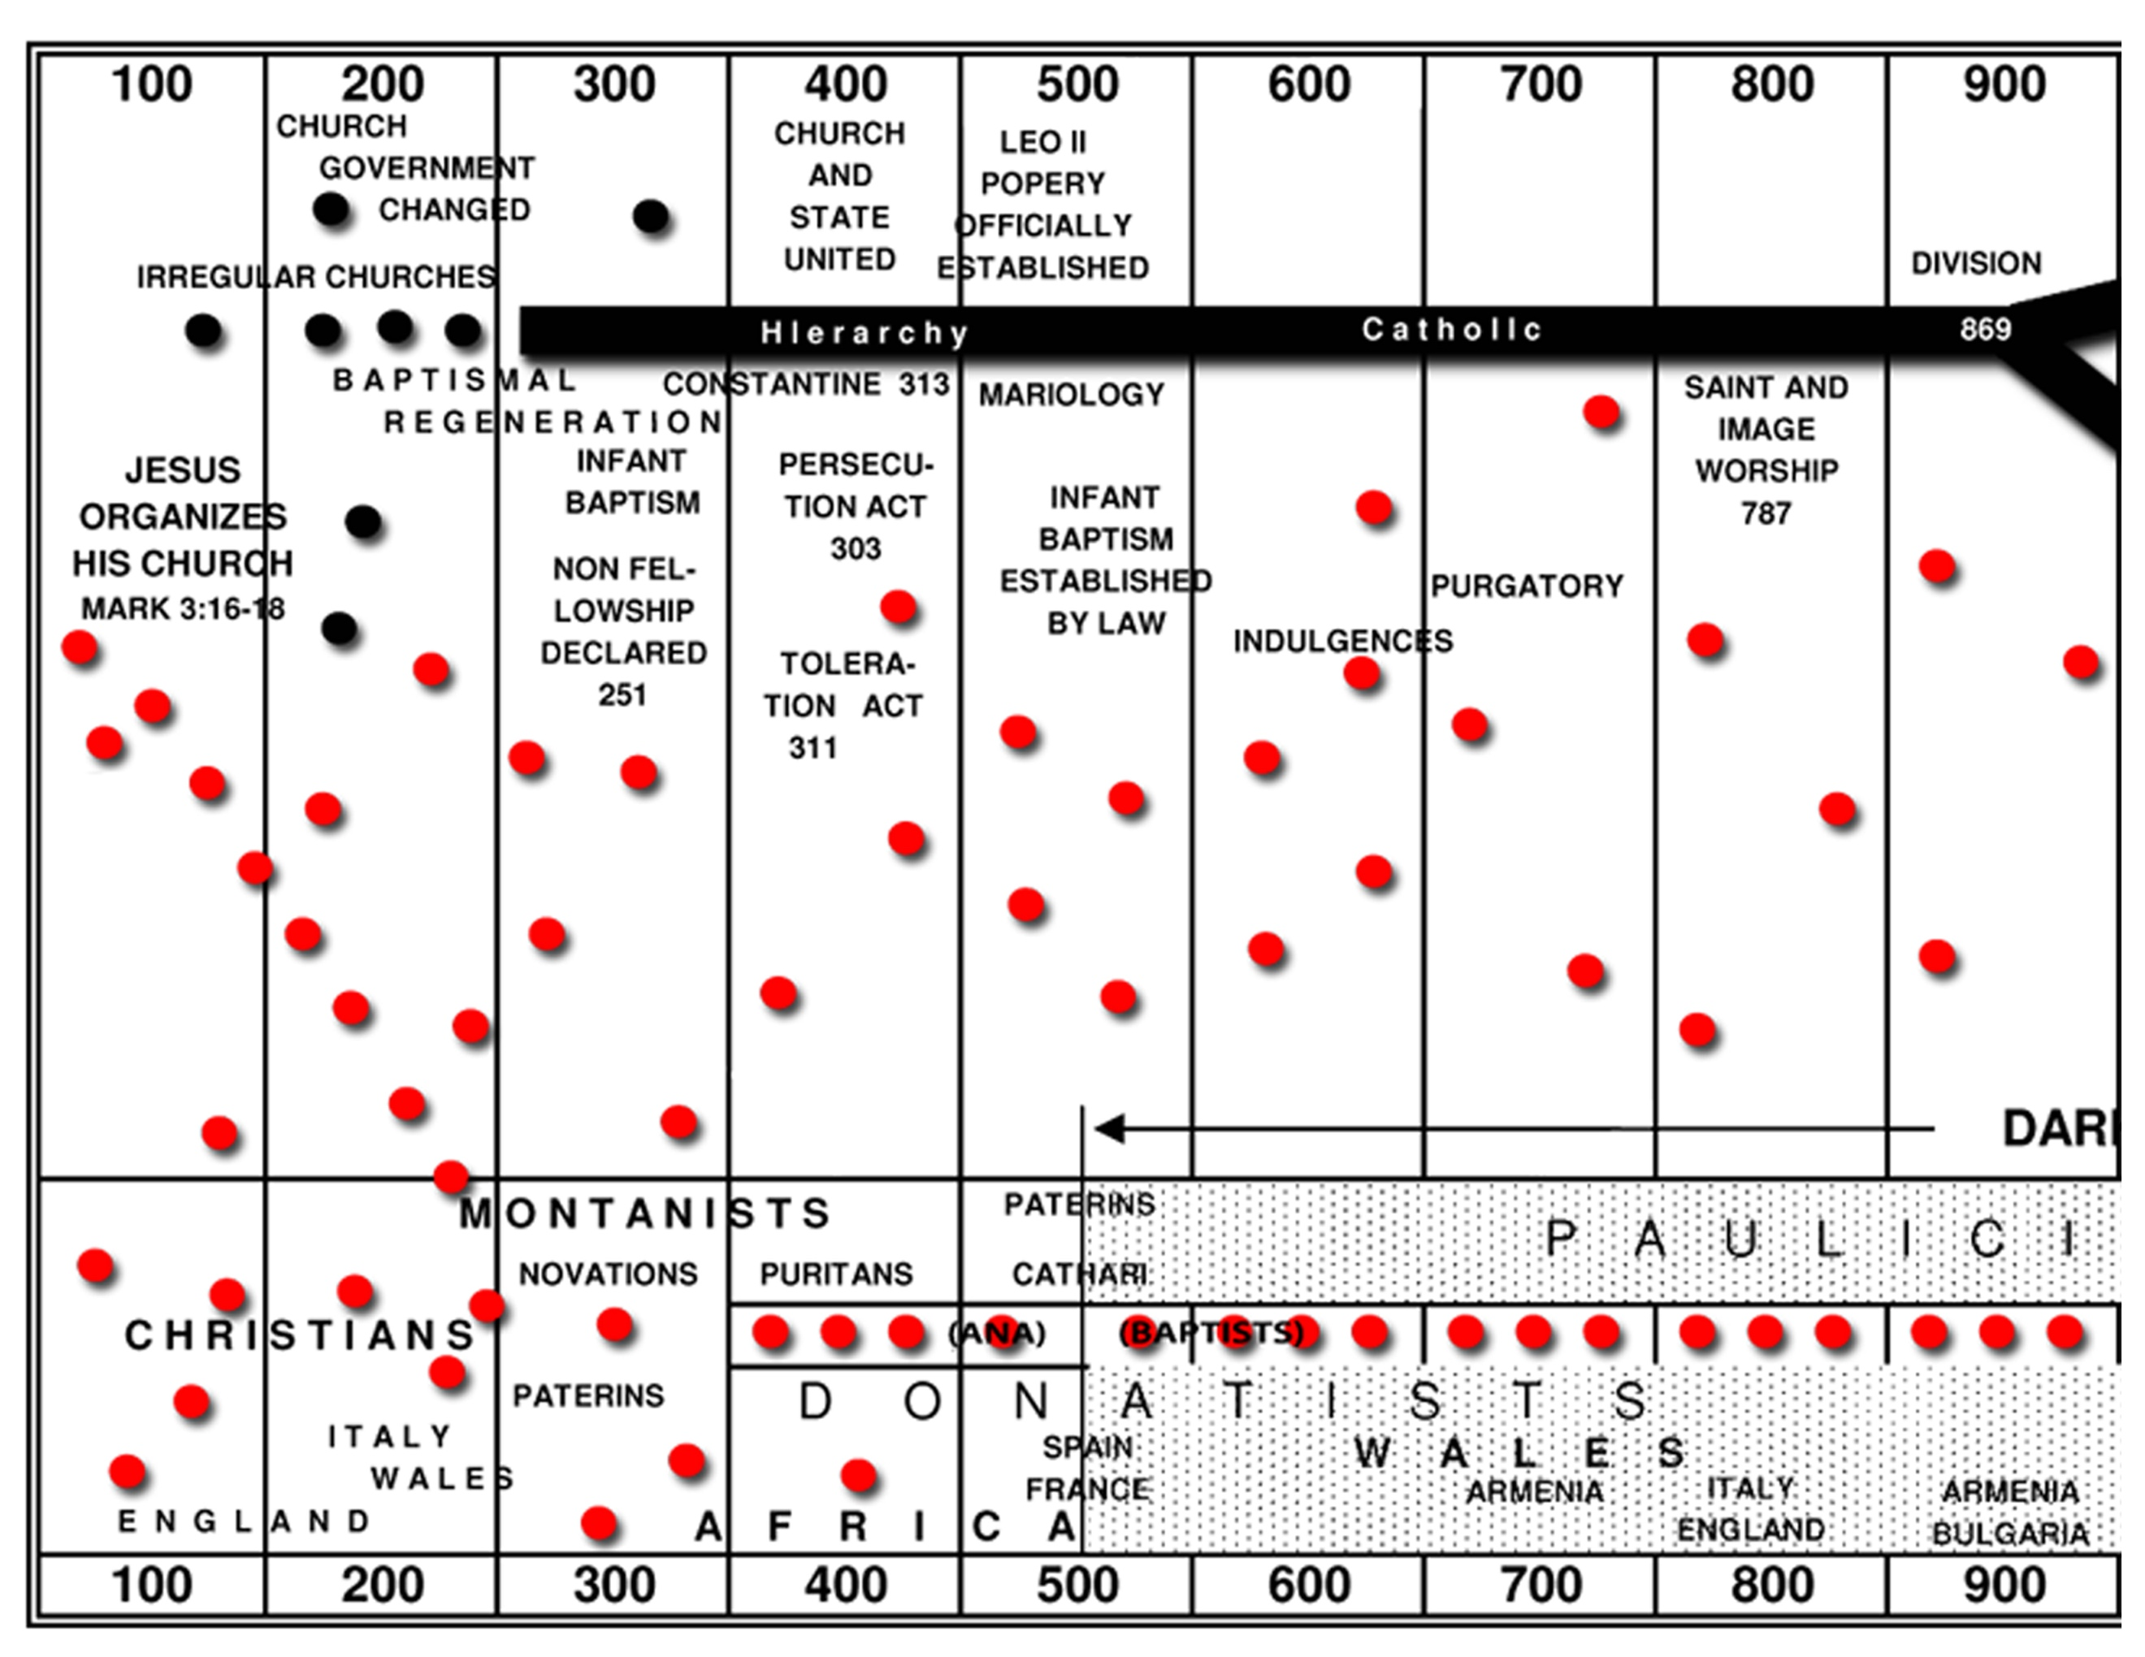

Slide 65
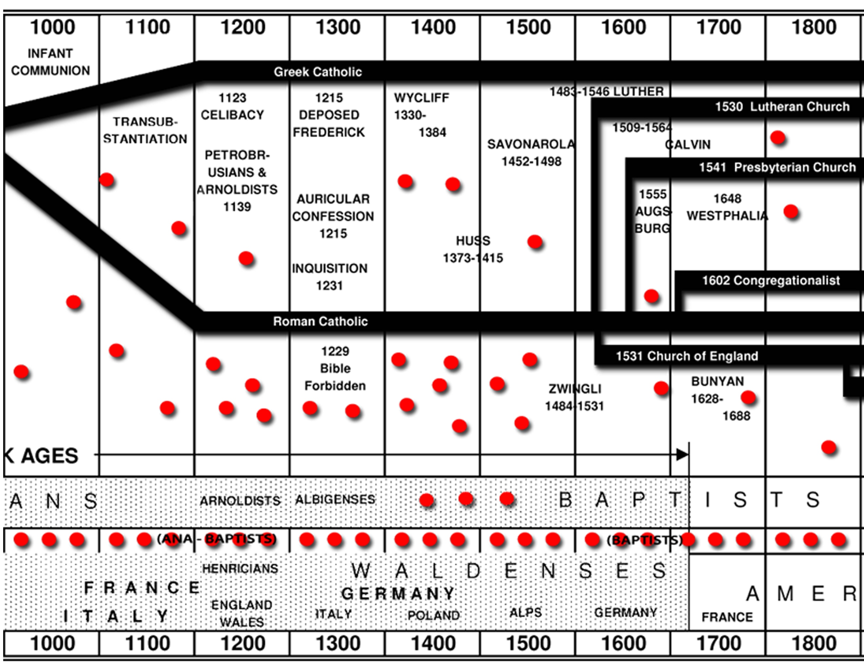

Slide 66
Backdrop
“In Catholic England, the only Bible available was written in Latin Vulgate, a translation of proper Latin considered holy by the Roman Catholic Church. As a result, only clergy had access to copies of the Bible. Countrymen were dependent on their local priests for the reading of scripture because they could not read the text for themselves.

Slide 67
Early in the Reformation, one of the fundamental disagreements between the Roman Church and Protestant leaders was over the distribution of the Bible in the people's common language. John Wycliffe helped make the Bible available to all people, regardless of their wealth or social standing. Wycliffe translated the whole Bible into the English language because he believed that Englishmen needed to be familiar with the scriptures on their own terms in order to know Jesus Christ.

Slide 68
In 1526, William Tyndale published the first complete Bible in print. This facilitated distribution at a lower cost, and soon the Bible was not only readable to English citizens, but also affordable for most people.

Slide 69
Tyndale’s N.T Translation 1525 A.D.
William Tyndale “was the first to translate the Bible into English from Greek (Byzantine) source. Nearly 90% of his work is still retained in the King James Bible. He died as a martyr for translating the Bible for common man.” “Tyndale's Bible is credited with being the first English translation to work directly from Hebrew and Greek texts. Furthermore, it was the first English biblical translation that was mass-produced as a result of new advances in the art of printing.”

Slide 70
Tyndales N.T Translation 1525 A.D.
Coverdale Bible
Matthews Bible
Miles Coverdale
Continued Tyndales Work

Slide 71
Geneva Bible 1560 AD
The Geneva Bible is one of the most historically significant translations of the Bible into English, preceding the King James Version by 51 years. It was the primary Bible of 16th-century English Protestantism and was used by William Shakespeare, Oliver Cromwell, John Knox, John Donne, and John Bunyan, author of The Pilgrim's Progress (1678). It was one of the Bibles taken to America on the Mayflower (Pilgrim Hall Museum has collected several Bibles of Mayflower passengers).

Slide 72
The Geneva Bible was used by many English Dissenters, and it was still respected by Oliver Cromwell's soldiers at the time of the English Civil War, in the booklet "Cromwell's Soldiers' Pocket Bible". This version of the Bible is significant because, for the very first time, a mechanically printed, mass-produced Bible was made available directly to the general public which came with a variety of scriptural study guides and aids (collectively called an apparatus), which included verse

Slide 73
citations that allow the reader to cross-reference one verse with numerous relevant verses in the rest of the Bible, introductions to each book of the Bible that acted to summarize all of the material that each book would cover, maps, tables, woodcut illustrations and indices.
And in response to this we have the ‘Bishops Bible’ (1568)

Slide 74
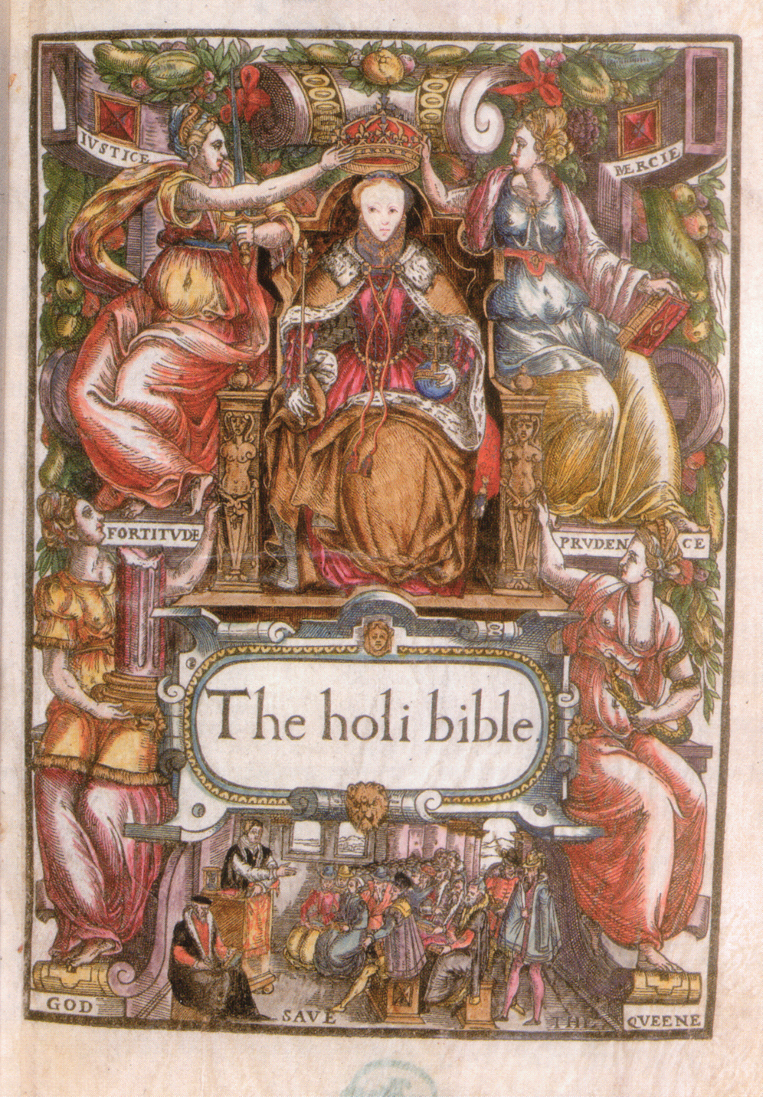

Slide 75
Beza’s Greek N.T. 1598 AD
Theodore Beza was the successor of John Calvin at Geneva. He also continued in the line of Received Text editions. His 1598 Greek edition was used heavily by the King James translators. Beza believed his manuscripts were influenced by Waldensian Christians- an early group of Christians, outside of Catholicism, dating back to AD 120.
Robert Stephanus – Middle Man between Greek NT

Slide 76
King James Translation –
King James Version (KJV), also called Authorized Version or King James Bible, English translation of the Bible published in 1611 under the auspices of King James I of England. The translation had a marked influence on English literary style and was generally accepted as the standard English Bible from the mid-17th to the early 20th century.

Slide 77
The reign of Queen Elizabeth I (1558–1603) succeeded in imposing a high degree of uniformity upon the Church of England. Protestantism was reinstated as the official religion of England after the short reign of Mary I (1553–58), who had attempted to restore Roman Catholicism in the country. In 1604, soon after James’s coronation as king of England, a conference of churchmen requested that the English Bible be revised because existing translations “were corrupt and not answerable to the truth of the original.”

Slide 78
The Great Bible that had been authorized by Henry VIII (1538) enjoyed some popularity, but its successive editions contained several inconsistencies. The Bishops’ Bible (1568) was well regarded by the clergy but failed to gain wide acceptance or the official authorization of Elizabeth.

Slide 79
The most popular English translation was the Geneva Bible (1557; first published in England in 1576), which had been made in Geneva by English Protestants living in exile during Mary’s persecutions. Never authorized by the crown, it was particularly popular among Puritans but not among many more-conservative clergymen.

Slide 80
Not since the Septuagint—the Greek-language version of the Hebrew Scriptures (Old Testament) produced between the 3rd and the 2nd centuries BCE—had a translation of the Bible been undertaken under royal sponsorship as a cooperative venture on so grandiose a scale. An elaborate set of rules was contrived to curb individual proclivities and to ensure the translation’s scholarly and nonpartisan character.

Slide 81
The translators used not only extant English-language translations, including the partial translation by William Tyndale (c. 1490–1536), but also Jewish commentaries to guide their work. The wealth of scholarly tools available to the translators made their final choice of rendering an exercise in originality and independent judgment. For this reason, the new version was more faithful to the original languages of the Bible and more scholarly than any of its predecessors.

Slide 82
The impact of the original Hebrew upon the revisers was so pronounced that they seem to have made a conscious effort to imitate its rhythm and style in their translation of the Hebrew Scriptures.

